Slide 1
Basics of Biomedical Separation

Slide 2
What types of properties do we want/need to separate biomolecules?

Slide 3
What types of properties do we want/need to separate biomolecules?
Mass
Isoelectric point/charge
Hydrophobicity/Hydrophilicity
Size
Solubility
Affinity
Density
Boiling point
Activity

Slide 4
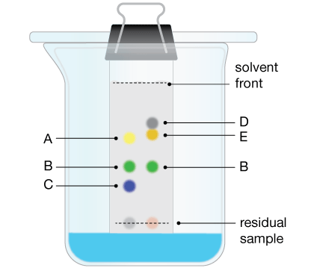
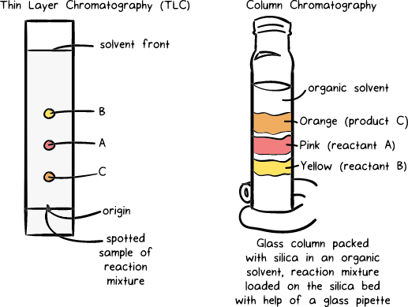
Basic Chromatographic Setup

Slide 5
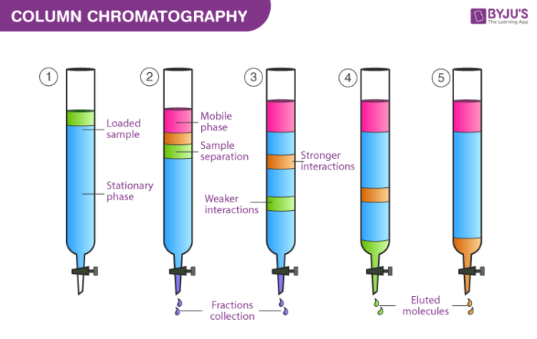
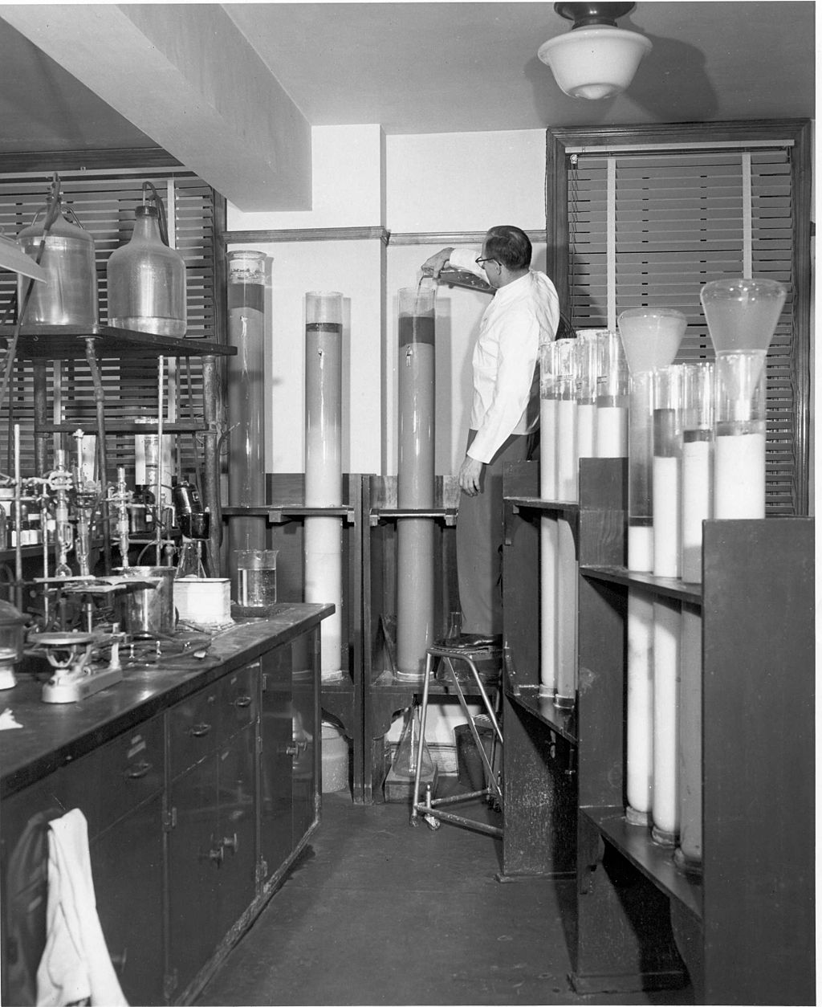
Column Chromatography
A column is packed with a solid absorbent (stationary phase) in a glass/plastic tube
Effluent (mobile phase) is passed over the column.
Individual components are retained by the stationary phase differently and separate from each other while they are running at different speeds through the column with the eluent. At the end of the column, they elute one at a time.
https://byjus.com/chemistry/differential-extraction-chromatography/
By The U.S. Food and Drug Administration - https://www.flickr.com/photos/fdaphotos/4899254776/, Public Domain, https://commons.wikimedia.org/w/index.php?curid=37870980

Slide 6
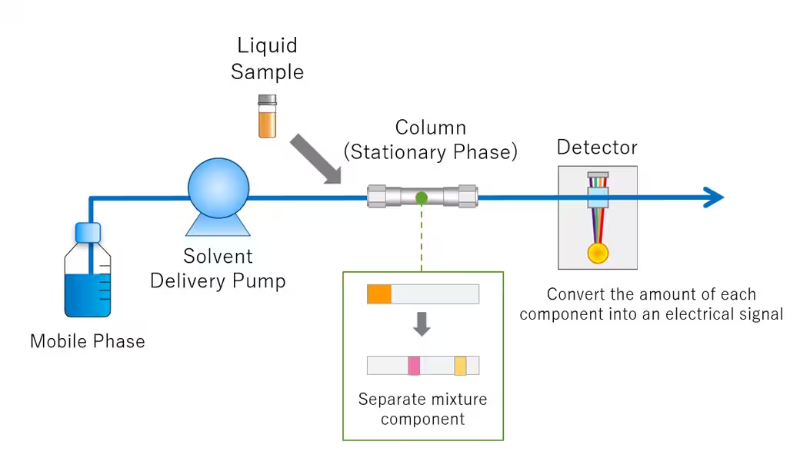
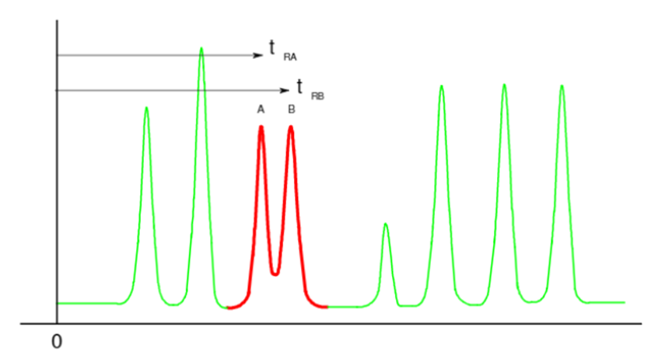
Basic HPLC (high performance liquid chromatography) setup
Intensity
Time

Slide 7
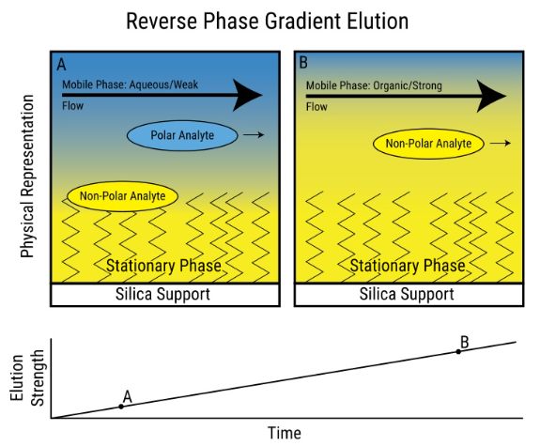
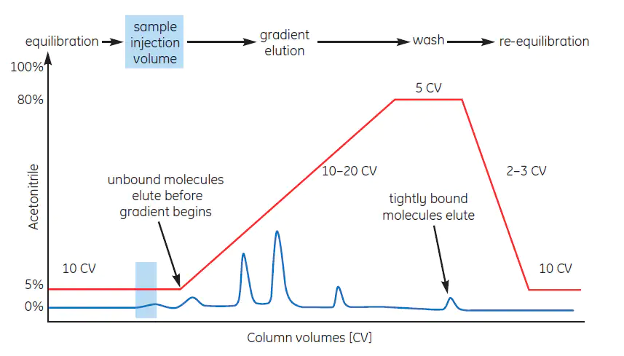
Reversed Phase Chromatography
Frequently done at high pressure (HPLC and now UPLC)
https://www.sigmaaldrich.com/US/en/technical-documents/protocol/analytical-chemistry/purification/reverse-phased-chromatography-in-practice

Slide 8

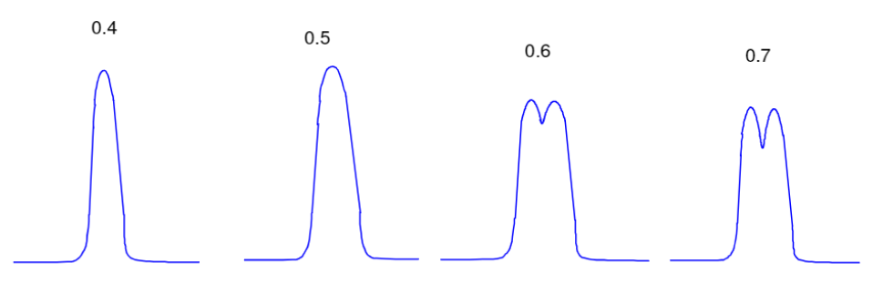
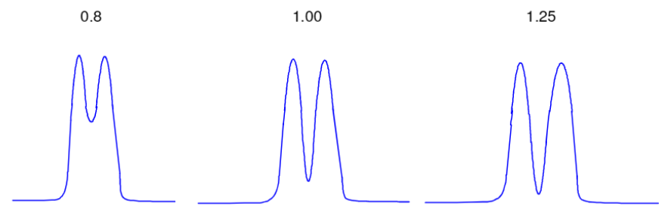
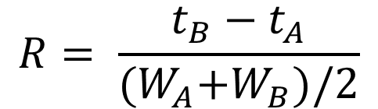
How do we evaluate separations?
Resolution – How well separated are two components
$$R= \frac{t_{B}−t_{A}}{{(W}_{A}+W_{B})/2}$$
W = width at base
W

Slide 9
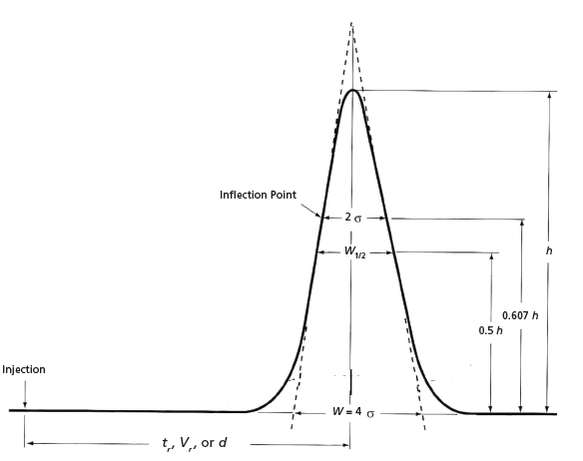

How do we evaluate separations?
Peak Capacity – maximum number of molecular species that can be separated
$$P_{c}= \frac{t_{l}−t_{f}}{\overline{W}}$$

Slide 10
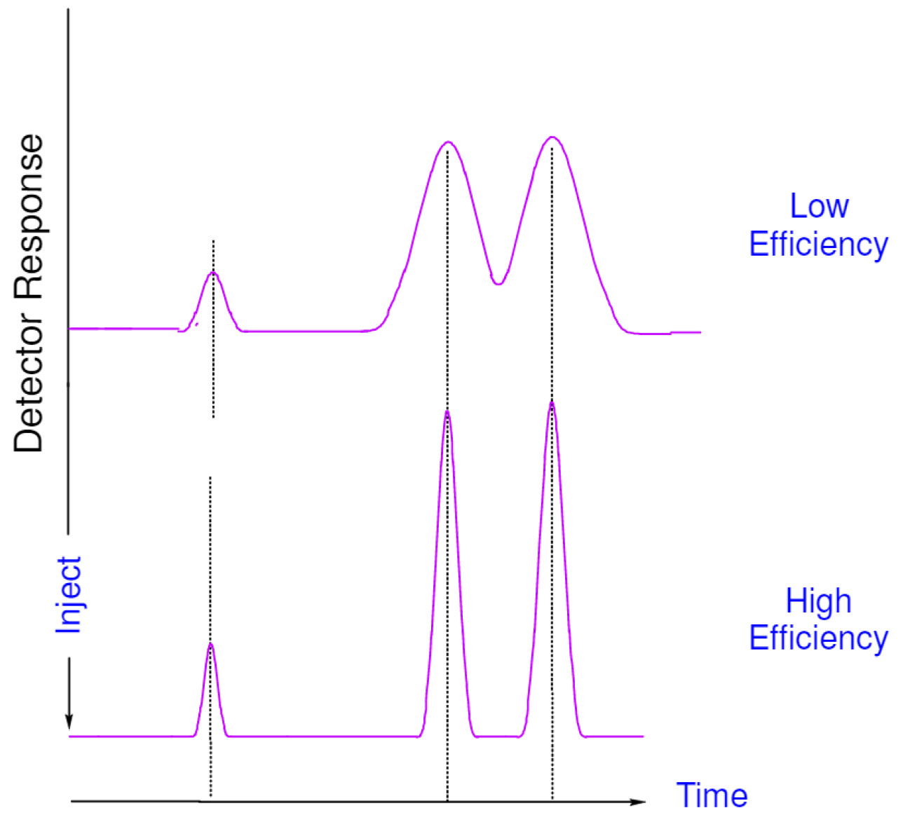

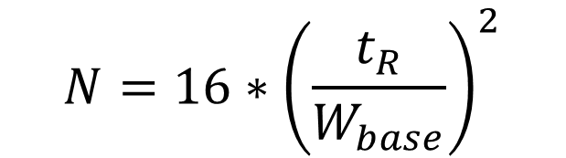
How do we evaluate separations?
Theoretical Plates – is a measure of the efficiency of the separation
$$N= {\left(\frac{t_{R}}{σ}\right)}^{2}$$
$$N=16∗{\left(\frac{t_{R}}{W_{base}}\right)}^{2}$$
Concept originated to evaluate fractional distillation which had different physical stages. Was meant to provide a measure of efficiency as it related to the number of physical steps. Meant to represents the distance that was needed for every adsorption-desorption step

Slide 11
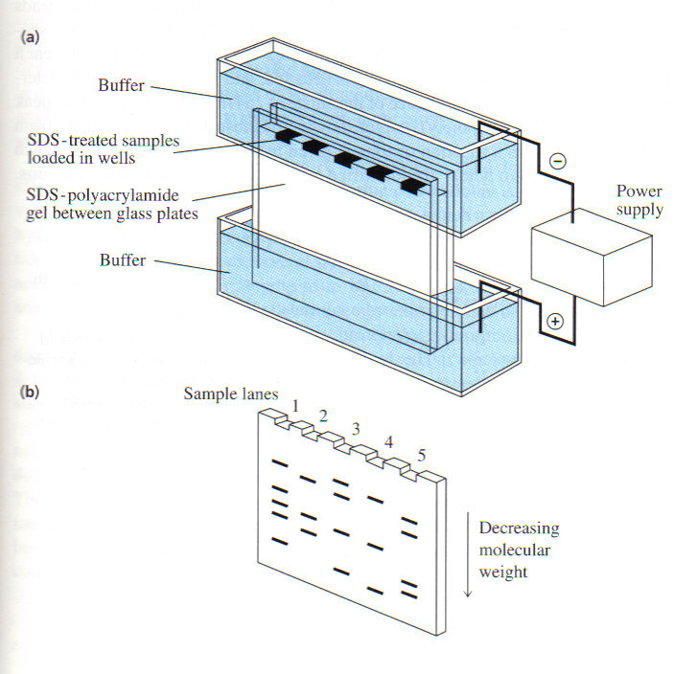
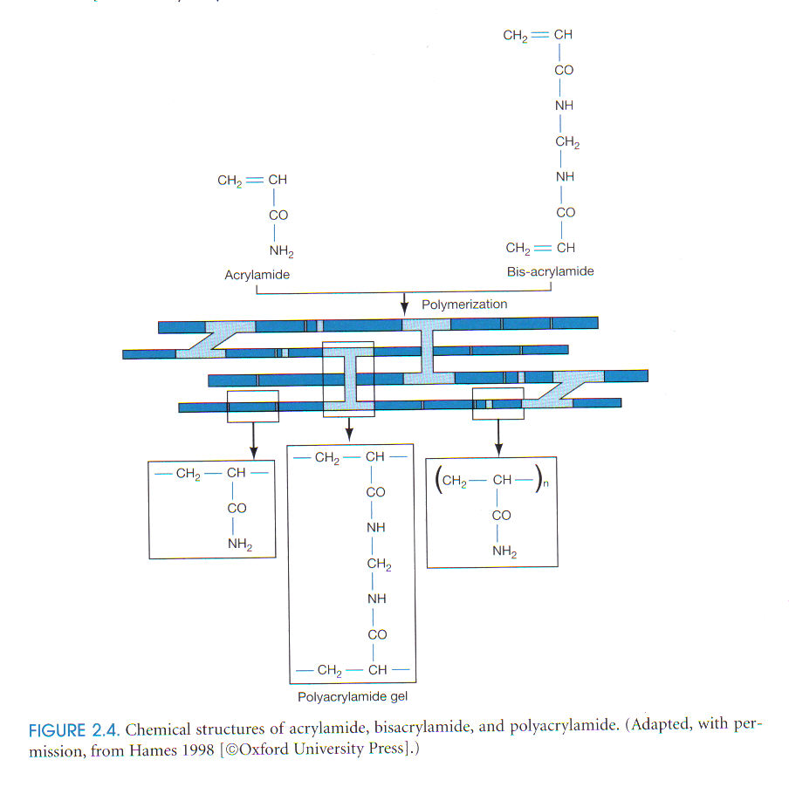
SDS-PAGE (sodium dodecyl sulfate–polyacrylamide gel electrophoresis)
Separation by molecular weight
Any charge swamped by negatively charged SDS molecules
SDS denatures the protein

Slide 12
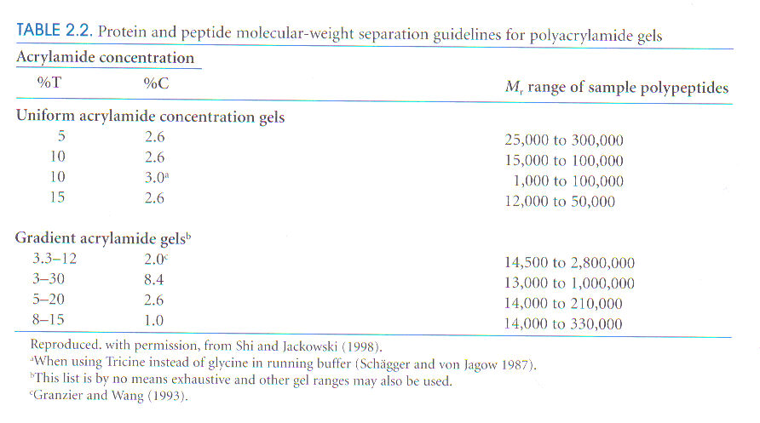
T = Percentage of acrylamide and bisacrylamide in grams / ml
C = Percentage of crosslinker bisacrylamide
Pore size reduced reciprocally to the %T

Slide 13
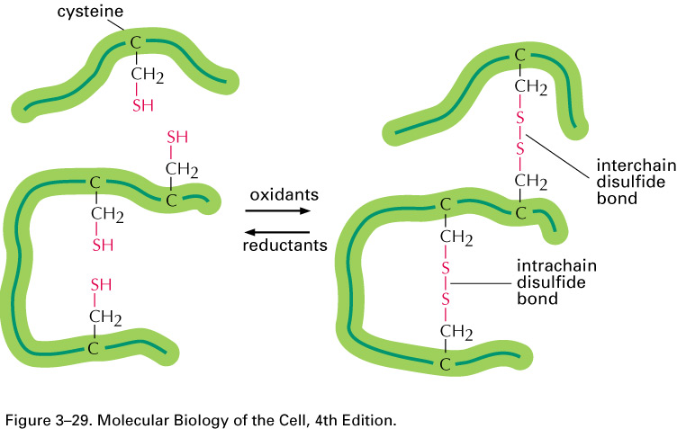
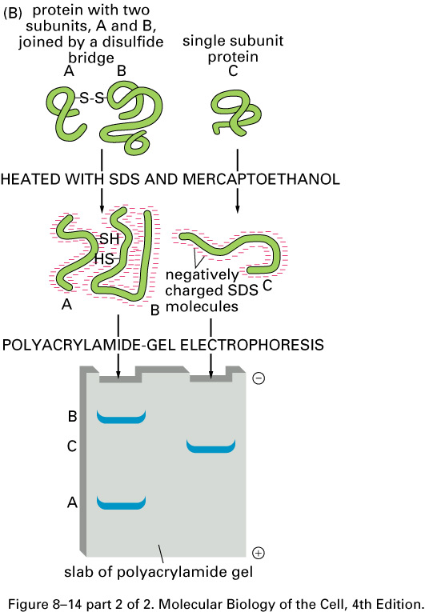
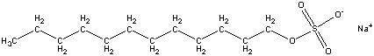

Slide 14
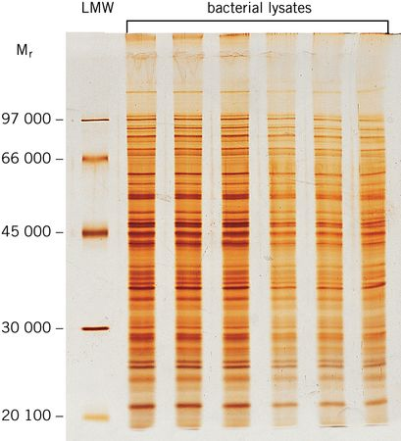
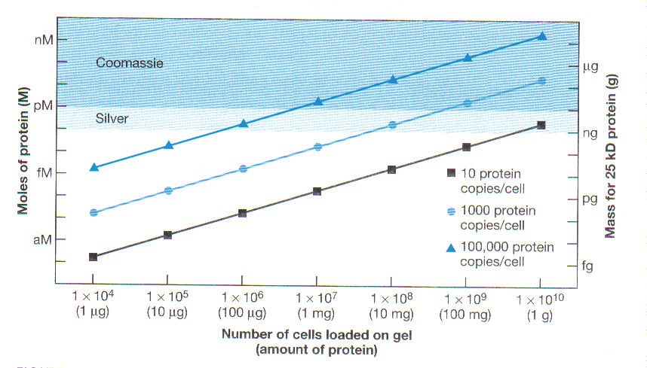

Slide 15
Uses of SDS-PAGE
Determine protein size
Identify protein
Determine sample purity
Identify existence of disulfide bonds
Quantify amounts of protein

Slide 16
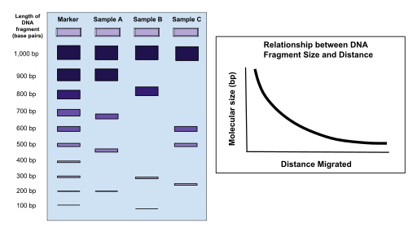
DNA Electrophoresis works in a similar way
Normally use agarose gels (made from polysaccharide, galactose monomers)
Detection with ethidium bromide (EtBr), SYBR Green, or GelRed
Fluoresces when exposed to UV light
Notes:
DNA molecules are negatively charged due to their phosphate backbone. When placed in an electric field, they migrate toward the positive electrode (anode). The rate of migration depends on the size of the DNA fragments - smaller fragments move faster through the gel matrix than larger ones.
Gel Preparation: Agarose powder is mixed with a buffer solution (typically TAE or TBE) and heated until dissolved. The concentration of agarose (typically 0.7-2%) determines the pore size and separation range of the gel.
Gel Casting: The molten agarose solution is poured into a casting tray with a comb inserted to create wells. As the gel cools, it solidifies into a matrix with a network of pores.
Sample Loading: DNA samples are mixed with a dense loading dye (containing glycerol or sucrose) and a tracking dye. The loading dye helps the sample sink into the wells, while the tracking dye allows visual monitoring of the migration.
Electrophoresis: The gel is placed in an electrophoresis chamber filled with the same buffer used to make the gel. An electric field is applied (typically 1-10 V/cm). The negatively charged DNA molecules begin migrating through the gel toward the positive electrode.
Separation: Smaller DNA fragments navigate through the pores of the gel more easily than larger fragments, causing them to migrate faster. This creates a separation based on size. Visualization: After electrophoresis, the gel is stained with a DNA-binding dye (like ethidium bromide, SYBR Green, or GelRed). When exposed to UV light, the dye-DNA complex fluoresces, making the DNA bands visible.

Slide 17
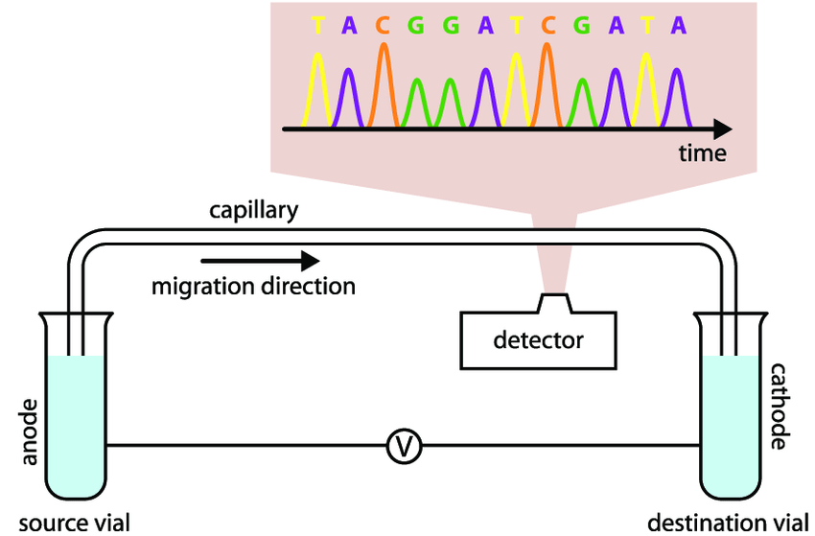
Capillary Electrophoresis
Anode +
Cathode -
https://link.springer.com/protocol/10.1007/978-1-60327-375-6_6

Slide 18
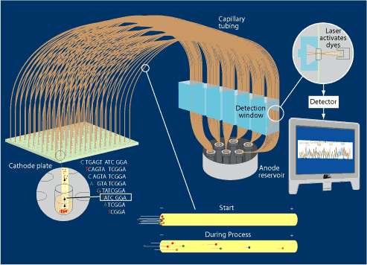

Slide 19
Western Blotting
Combines resolution of SDS-PAGE with specificity of antibody detection.
What you can find out:
Presence of an antigen
Amount of an antigen present
Molecular Weight of antigen
Allows for the identification of a single protein in a complex mixture

Slide 20
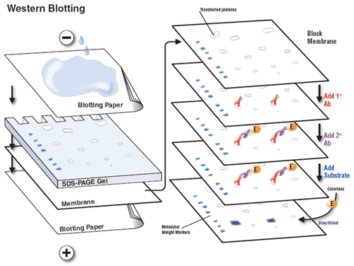

Slide 21
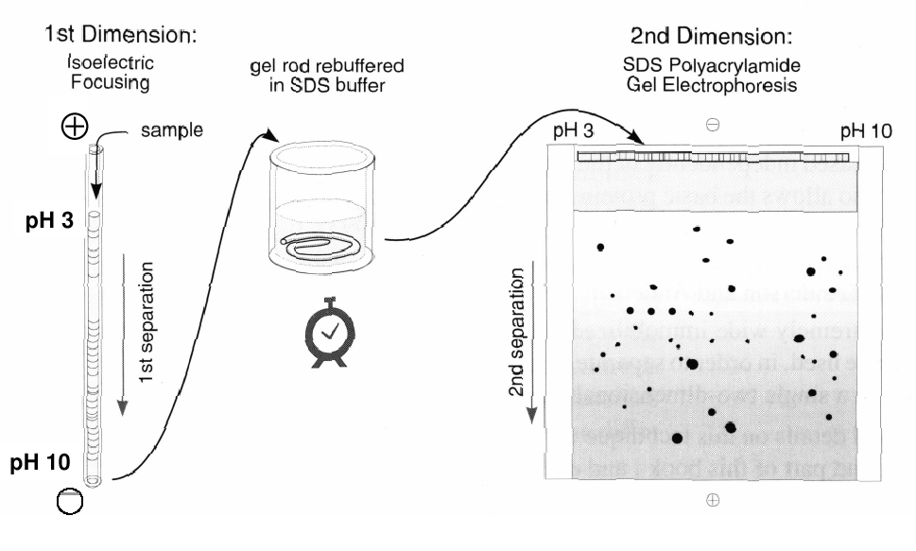
2D Gel methodology According to O’Farrell
Notes:
O'Farrell‘s advisor, Pène, left Boulder around this time, but O'Farrell stayed on to complete his degree under the sponsorship of David Hirsh. After defending his thesis, O'Farrell submitted his two-dimensional electrophoresis manuscript to the JBC and moved to San Francisco to do postdoctoral studies with Gordon Tomkins in the Department of Biochemistry and Biophysics at the University of California, San Francisco (UCSF). Several months later, O'Farrell received a letter from the JBC rejecting his paper on the basis of two unfavorable reviews. The reviewers had concluded that the manuscript appeared to be “highly speculative in places and to be extrapolated in terms of usefulness far beyond what the author has any reason to expect.” Fortunately, with the help of several members of the journal's editorial board, the initial decision was reversed, and the paper was published. O'Farrell‘s JBC Classic went on to be one of the 50 most highly cited items in Web of Science. As of January 2004, it has been cited in over 16,244 publications.

Slide 22
Evolution of 2D-Gel methodology
SDS-PAGE Gel size:
This “O’Farrell” techniques has been used for 20 years without major modification.
20 x 20 cm have become a standard for 2D-Gel.
Assumption: 100 bands can be resolved by 20 cm long 1D-Electrophoresis.
Therefore, 20 x 20 cm gel can resolve 100 x 100 = 10,000 proteins, in theory.
100
100

Slide 23
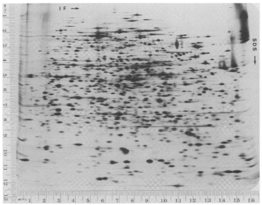
Separation of E. coli Proteins in 1975

Slide 24
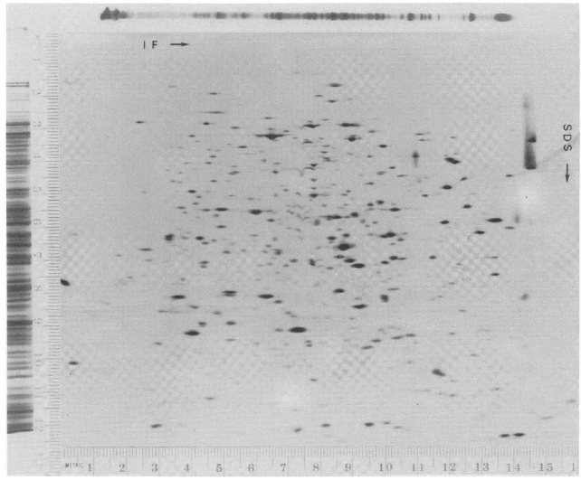
1D to 2D Comparison

Slide 25
Evolution of 2D-Gel methodology
Resolution for IEF: Immobilized pH gradients.
Reported first by Bjellqvist (1982, Biochem. Biophys Methods, vol 6, p317)
pH gradient are prepared by co-polymerizing acrylamide monomers with acrylamide derivatives containing carboxylic and tertiary amino groups.
The pH gradient is fixed, not affected by sample composition.
Reproducible data are presented.
Higher loading capacity than with carrier ampholytes
Modified by Angelika Gorg by using thin film to support the thin polyacrylamide IEF gel, named Strips. (1988, Electrophoresis, vol 9, p 531)
CH₂
CN
C
N
R
CH₂
CN
C
N
H
O
H
O
H
R = amino or carboxylic groups
Acrylamide

Slide 26
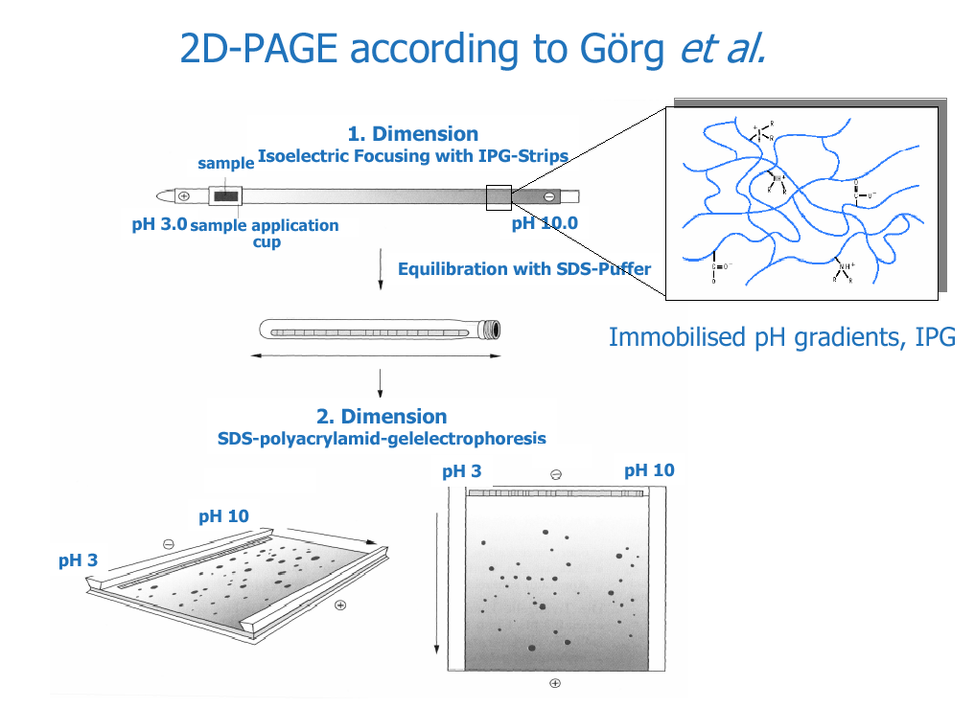

Slide 27
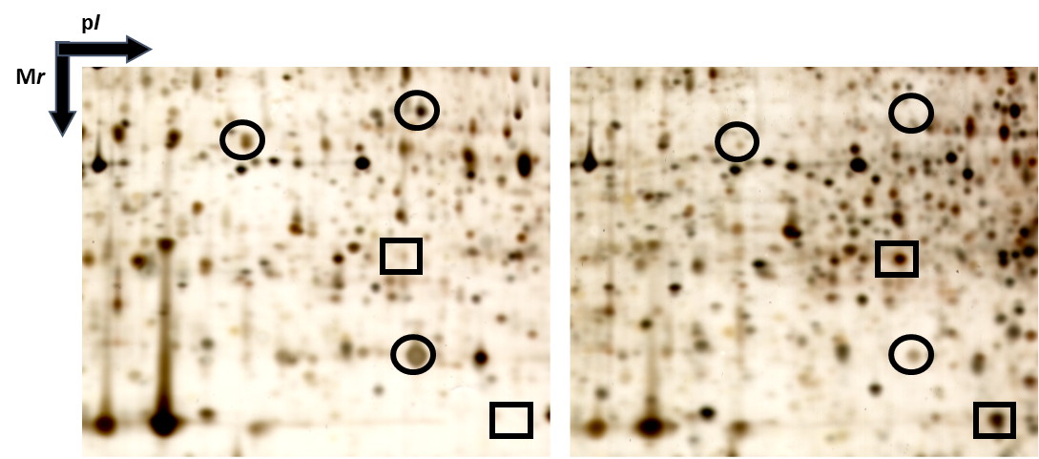

Slide 28
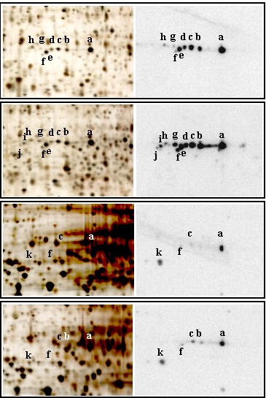
Silver
Immunoblot
CTL Golgi
CHX Golgi
CTL cytosol
CHX cytosol

Slide 29
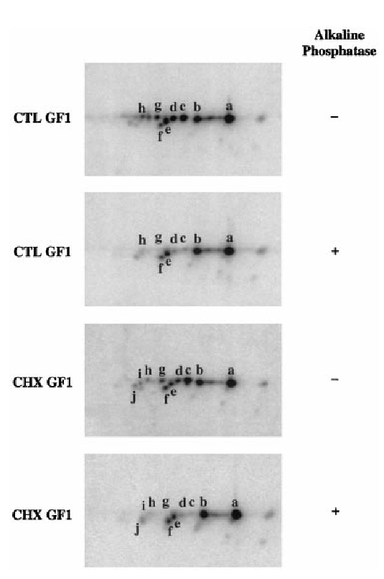

Slide 30
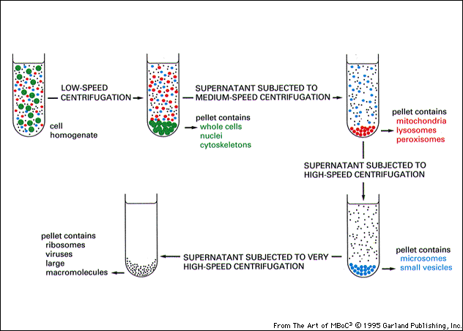
Subcellular Fractionation by Sedimentation

Slide 31
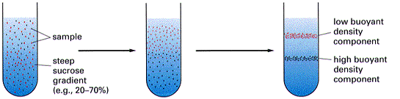
Separation using Gradient Centrifugation

